Slide 1
Measuring single chain dynamics in a polymer melt: from Rouse motion to entanglement distances
Apoorv Balwani, Shankar Ram, Saptarshi Chakraborty, Madhu Pallaka, Nicole Michenfelder-Schauser, Yuan Wei, Caitlyn Wolf
NCNR NIST Summer School 2017

Slide 2
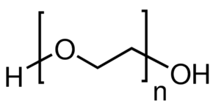


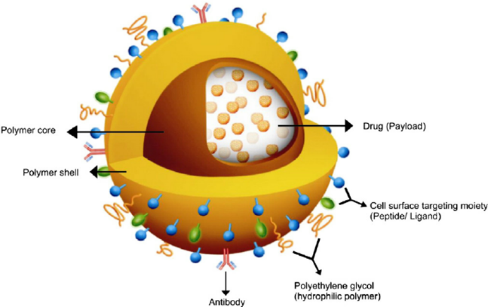

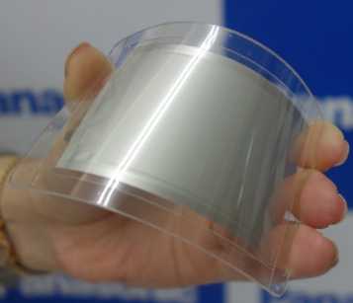

Poly(Ethylene Oxide) PEO
Bio compatible
Hydrophilic
Tunable mechanical properties
Drug delivery
Batteries

Slide 3
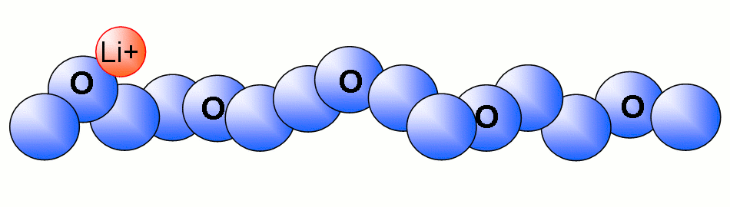

Why are dynamics important?
Amorphous domains
PEO
T_{g} = 213 K
T_{m} = 340K
Entanglement M_{w} =2 Kg/mol
Li⁺
Conduction mechanism in polymer electrolyte
Short length scales 0.1 nm
Long length scale >10nm

Slide 4
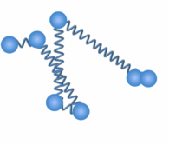
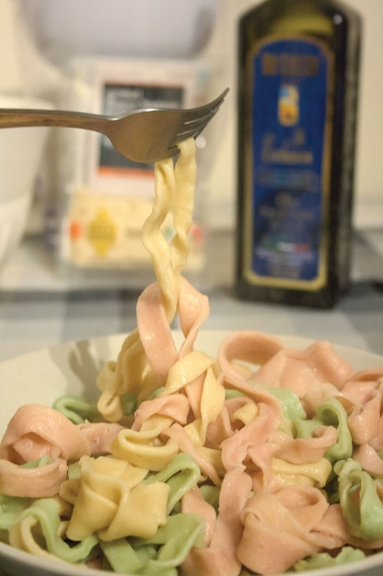
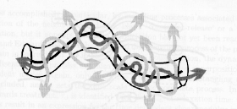
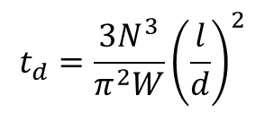
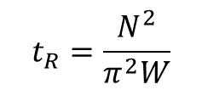
Rouse model
Dynamics models
Shorter chains or smaller length scales
l
$$t_{R}=\frac{N^{2}}{π^{2}W}$$
Reptation model
Longer chains or larger length scales
$$t_{d}=\frac{{3N}^{3}}{π^{2}W}{\left(\frac{l}{d}\right)}^{2}$$
d

Slide 5
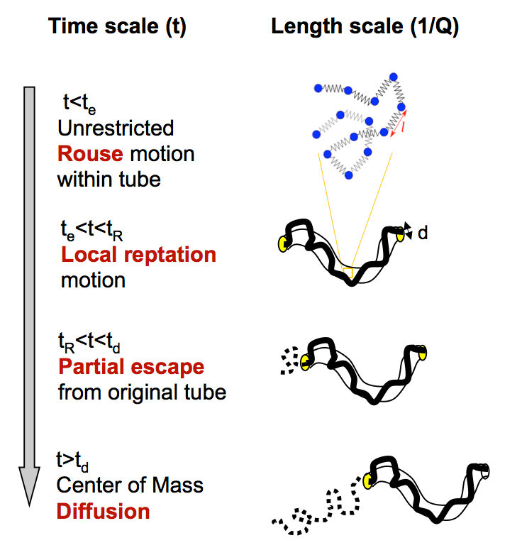

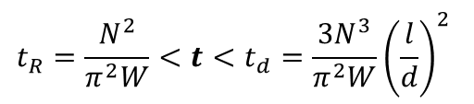

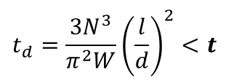
Dynamic crossover between different motions
$$t<t_{e}=\frac{d^{4}}{π^{2}Wl^{4}}$$
$$t_{e}=\frac{d^{4}}{π^{2}Wl^{4}}<t<t_{R}=\frac{N^{2}}{π^{2}W}$$
$$t_{R}=\frac{N^{2}}{π^{2}W}<t<t_{d}=\frac{{3N}^{3}}{π^{2}W}{\left(\frac{l}{d}\right)}^{2}$$
$$t_{d}=\frac{{3N}^{3}}{π^{2}W}{\left(\frac{l}{d}\right)}^{2}<t$$

Slide 6
Experimental details
35 kg/mol PEO
Temperature: 400 K (> T_{melt} = 340 K)
Glassy
α relaxation
Log G(t)
Rubbery Plateau
Terminal
t₀
t_{e}
t_{rep}
Log (t)
Rouse dynamics:
Time scale: < ~10 ns
Length scale: ~ 5.8 Å
(segment length)
Local reptation dynamics:
Time scale: > ~10 ns
Length scale: ~ 125 Å
(end-to-end distance)
Senses, E., Ansar, S.M., Kitchens, C.L., Mao, Y., Narayanan, S., Natarajan, B. and Faraone, A. Phys Rev Lett, 118 (2017).

Slide 7
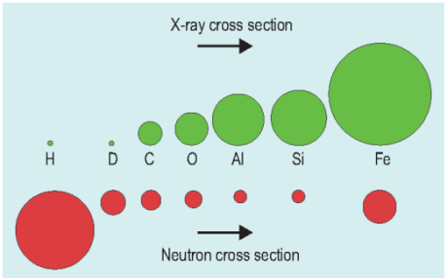
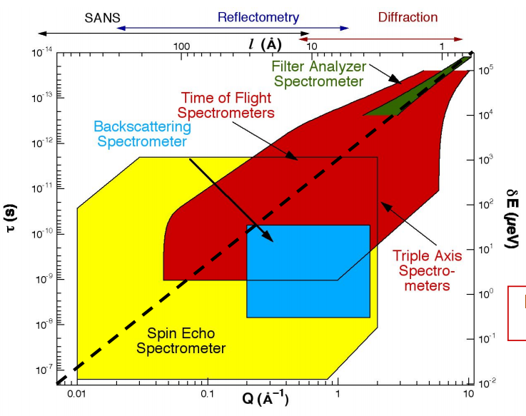
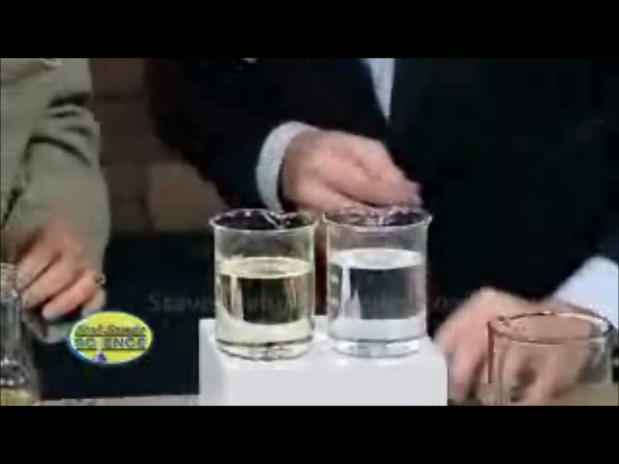
Neutrons are perfectly situated to study polymer dynamics
Strong force interaction
Contrast matching
Notes:
We all know that unlike x-rays, neutrons interact with the nuclei via the strong force instead of interacting with the electron cloud. This eliminates the strong dependence of scattering cross-section on atomic number and instead creates almost random scattering cross-sections. Contrast matching – deuterating most of the polymers and only some hydrogenated

Slide 8
Neutrons are perfectly situated to study polymer dynamics
Rouse
Reptation
Parameter | Value
Neutron wavelength | 5-15 Å
Wavelength distribution (Δλ/λ) | 0.1 to 0.2
Energy resolution | ~ 10 neV
Notes:
We all know that unlike x-rays, neutrons interact with the nuclei via the strong force instead of interacting with the electron cloud. This eliminates the strong dependence of scattering cross-section on atomic number and instead creates almost random scattering cross-sections. Contrast matching – deuterating most of the polymers and only some hydrogenated

Slide 9
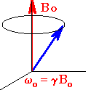
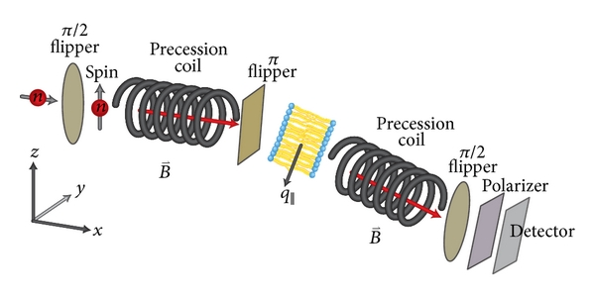
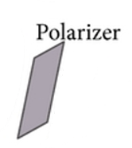
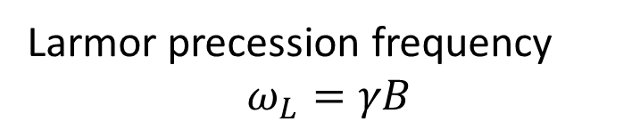
Scattering of neutron beam provides dynamics information
Larmor precession frequency
$$ω_{L}=γB$$
sample

Slide 10
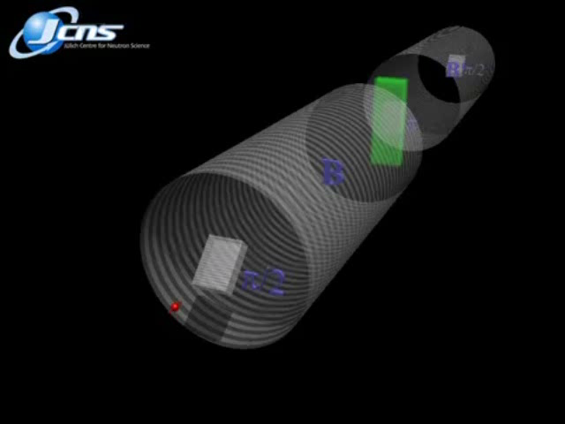
Scattering of neutron beam provides dynamics information
sample
Gif courtesy of Jülich NSE spectrometer facility

Slide 11
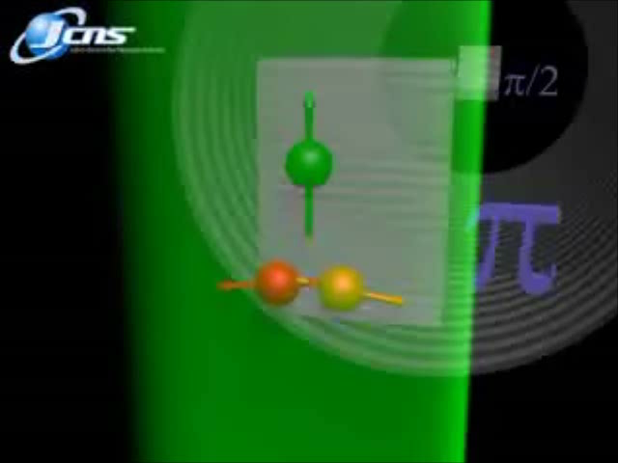
Scattering of neutron beam provides dynamics information
Elastic scattering
sample
Gif courtesy of Jülich NSE spectrometer facility

Slide 12
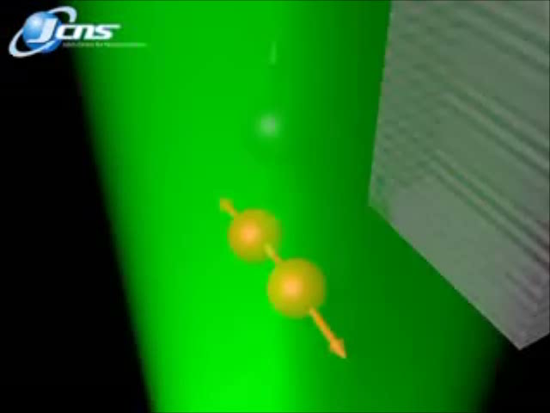
Scattering of neutron beam provides dynamics information
Inelastic scattering
sample
Gif courtesy of Jülich NSE spectrometer facility

Slide 13
Experimental details
35 kg/mol PEO
Temperature: 400 K (> T_{melt} = 340 K)
Contrast match: Mix 25% h-PEO and 75% d-PEO
75/25 d/h PEO
Rouse dynamics:
Neutron wavelength: 6 Å
Max Q: 0.3 Å^{–1}
Rouse dynamics:
Time scale: < ~ 10 ns
Length scale: ~ 5.8 Å
(segment length)
Local reptation dynamics:
Time scale: > ~ 10 ns
Length scale: ~ 125 Å
(end-to-end distance)
Local reptation dynamics:
Neutron wavelength: 11 Å
Min Q: 0.05 Å^{–1}

Slide 14
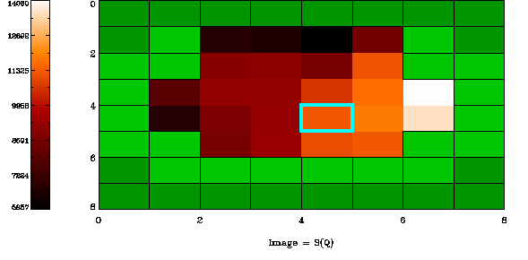
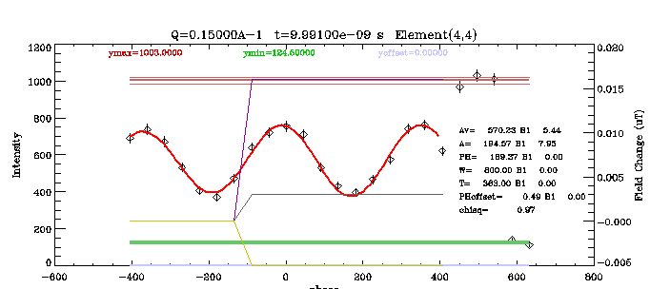
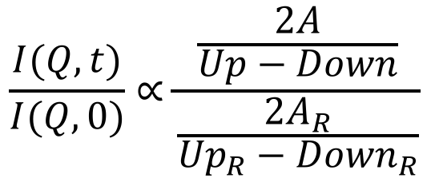
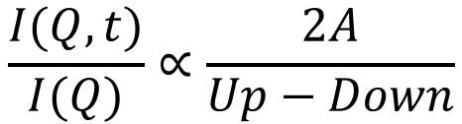
Data Reduction
echo amplitude
$$\frac{I(Q,t)}{I(Q)}∝\frac{2A}{Up−Down}$$
normalized to static polarization count
Up
Resolution is no
longer deconvolution…
A
$$\frac{I(Q,t)}{I(Q,0)}∝\frac{\frac{2A}{Up−Down}}{\frac{2A_{R}}{{Up}_{R}−{Down}_{R}}}$$
Down

Slide 15
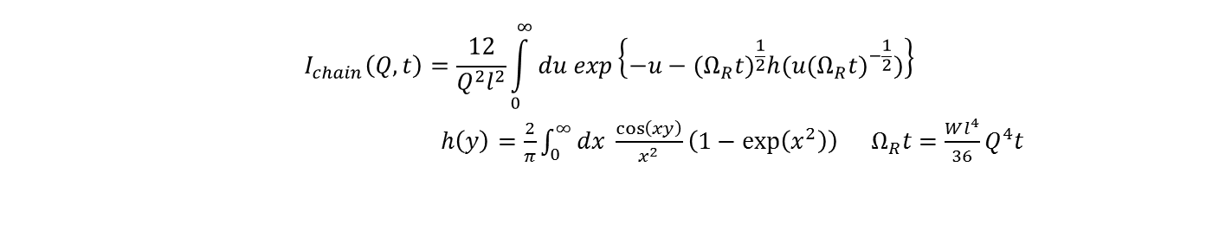
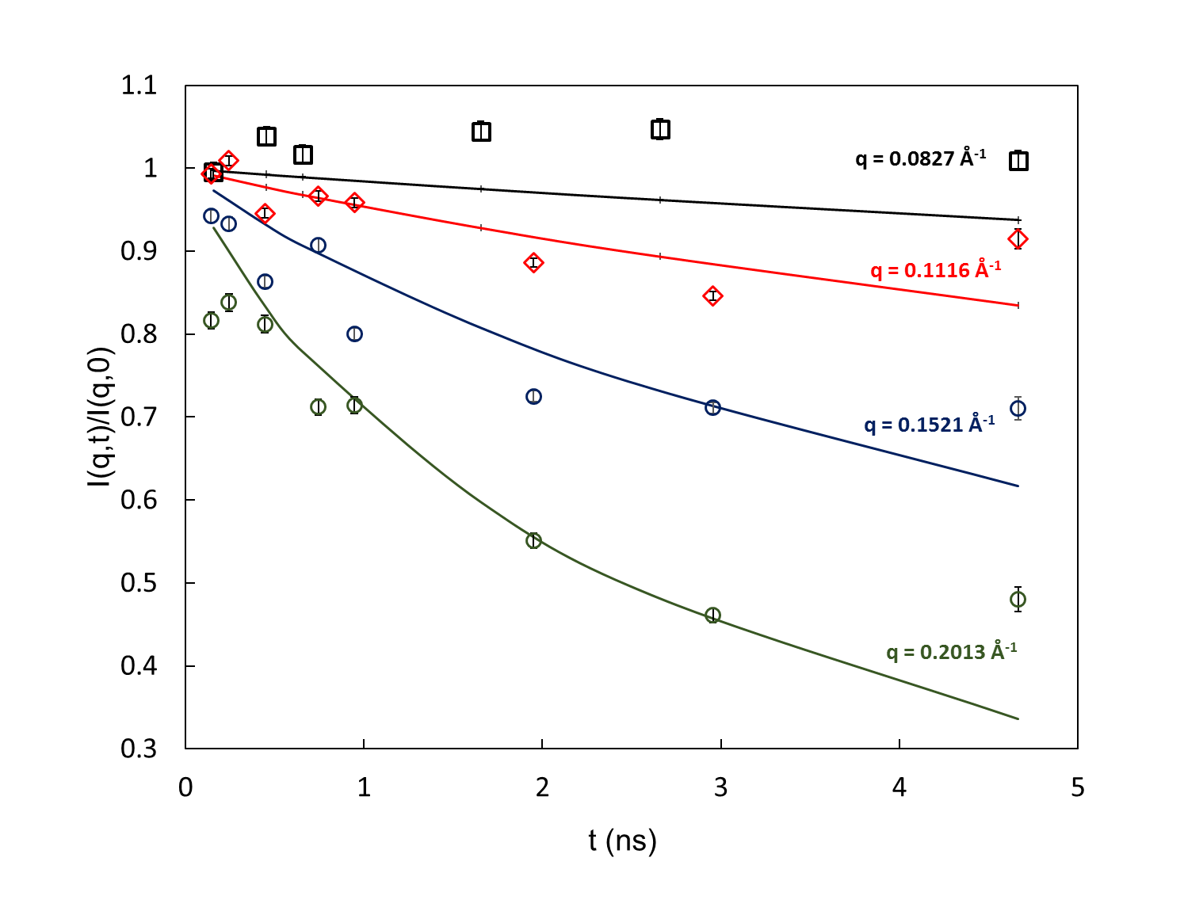
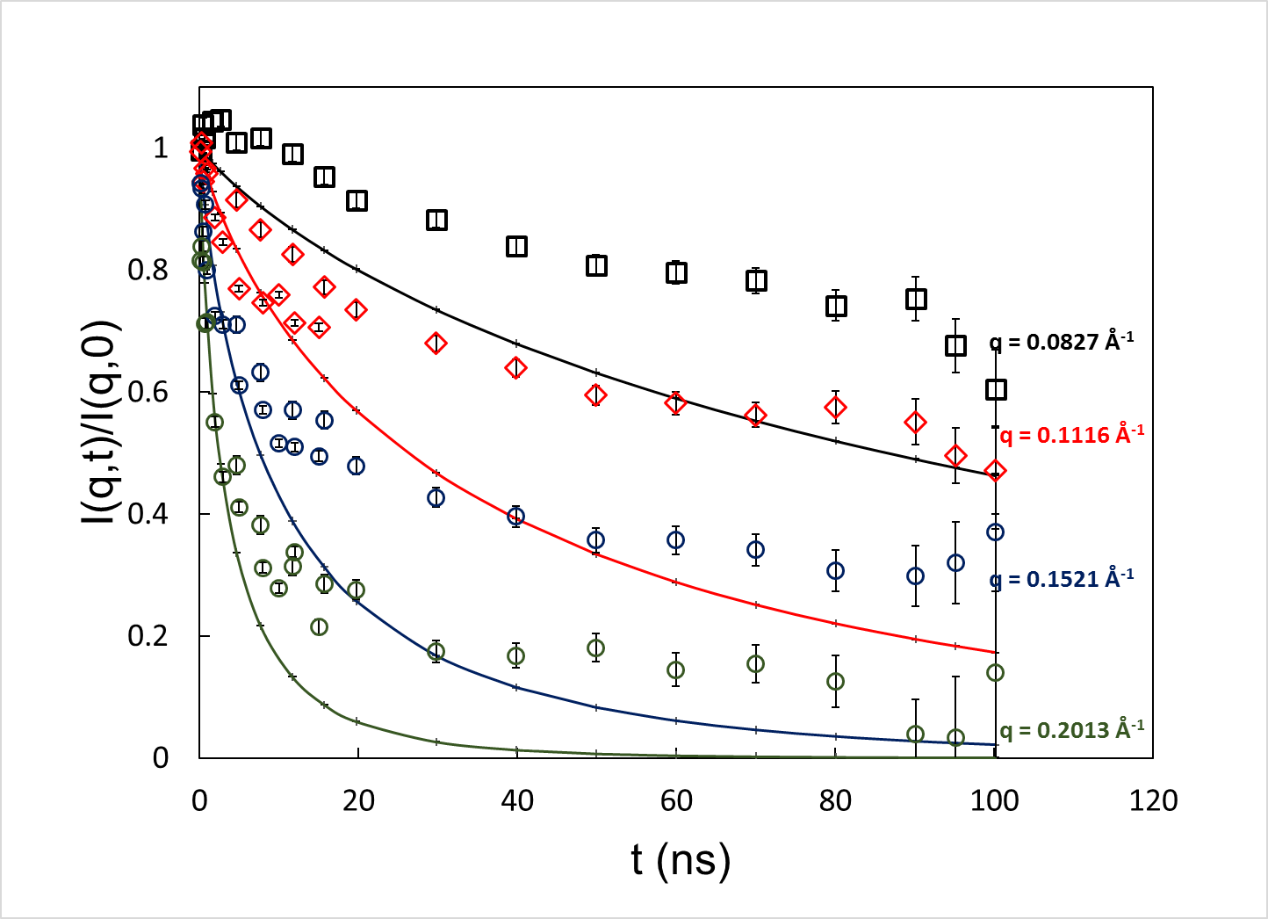
Results: Rouse dynamics
Wl⁴ = 1.391 ± 0.02254 nm⁴/ns

Slide 16
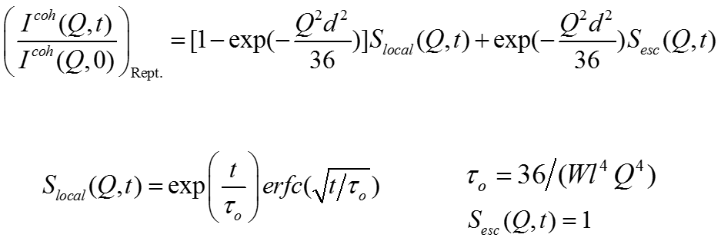
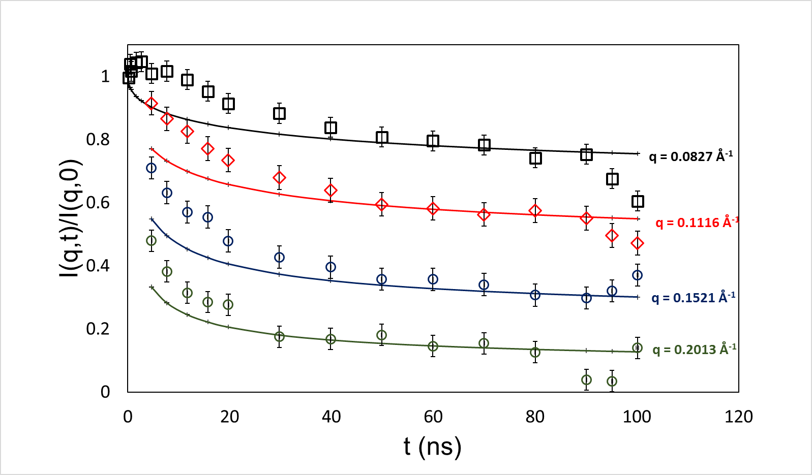
Results: Reptation dynamics
d = 49.74 ± 0.68 Å

Slide 17
Dynamic crossover between different motions
$$t<t_{e}=\frac{d^{4}}{π^{2}Wl^{4}}$$
t_{e} = 47 ns
$$t_{e}=\frac{d^{4}}{π^{2}Wl^{4}}<t<t_{R}=\frac{N^{2}}{π^{2}W}$$
$$t_{R}=\frac{N^{2}}{π^{2}W}<t<t_{d}=\frac{{3N}^{3}}{π^{2}W}{\left(\frac{l}{d}\right)}^{2}$$
$$t_{d}=\frac{{3N}^{3}}{π^{2}W}{\left(\frac{l}{d}\right)}^{2}<t$$

Slide 18
Conclusions
Neutron spin echo provides longest time scale and length scale for dynamics measurements
Rouse and local reputation dynamics of complex systems can not be determined by other means (e.g. rheology)
Cross-over time between Rouse and local reptation modes can be calculated: 47 ns
T = 400 K
 | Tube Diameter (Å) | τ_{e} (ns)
Niedzwiedz et al. ; 2008 | 49.74 | 47.3
Our Data | 52.6 | 51.2

Slide 19


Acknowledgments
Guardians of the NSE
Antonio Faraone
Elizabeth Kelly
Michi Nagao
Robert Bradbury
Erkan Senses
Arrangers: School of Neutrons
Alex Grutter
Rebecca Ogg
Yamali Hernandez
Last but in no way the least

Slide 20
Thank you!

Slide 21
t_{d}= 10 ^-7 s
Gplateau = 1.2 MPa

Slide 22
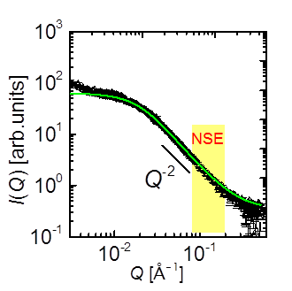
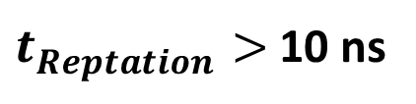
Choice of wavelengths
2π/R_{E} <Q = 2π/λ
0.05 Å⁻¹< Q < 0.3 Å⁻¹
$$t_{e}=\frac{d^{4}}{π^{2}Wl^{4}}$$
$t_{Reptation}>$ 10 ns

Slide 23
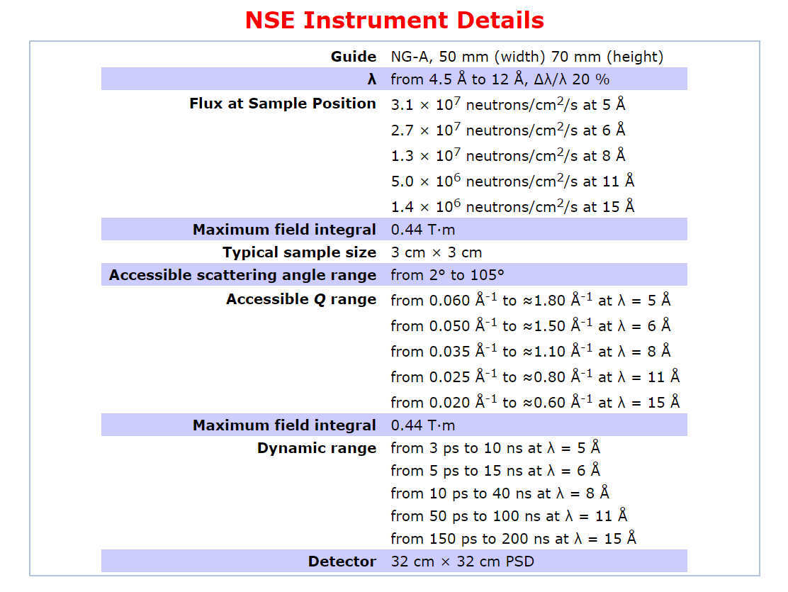
Choice of wavelengths

Slide 24
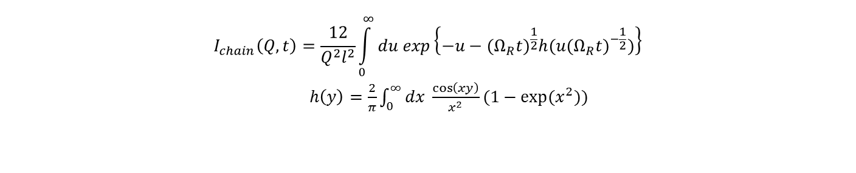
Polymer dynamics models modified to Fourier space & time
Modified Rouse model
$$I_{chain}\left(Q,t\right)=\frac{12}{Q^{2}l^{2}}\int_{0}^{∞}{du exp\left\{−u−({Ω_{R}t)}^{\frac{1}{2}}h(u({Ω_{R}t)}^{−\frac{1}{2}})\right\}}$$
$h\left(y\right)=\frac{2}{π}\int_{0}^{∞}{dx \frac{\cos\left(xy\right)}{x^{2}}(1−\exp{(x^{2})})}$
Modified reputation model

Slide 25
Neutrons in magnetic field
Number of precessions that neutrons go through
Here, J_{max} = 0.5 T.m @ 400 Å
J_{min} = 0.5/400 T.m @ 1 Å
The diffraction experiment

Slide 26
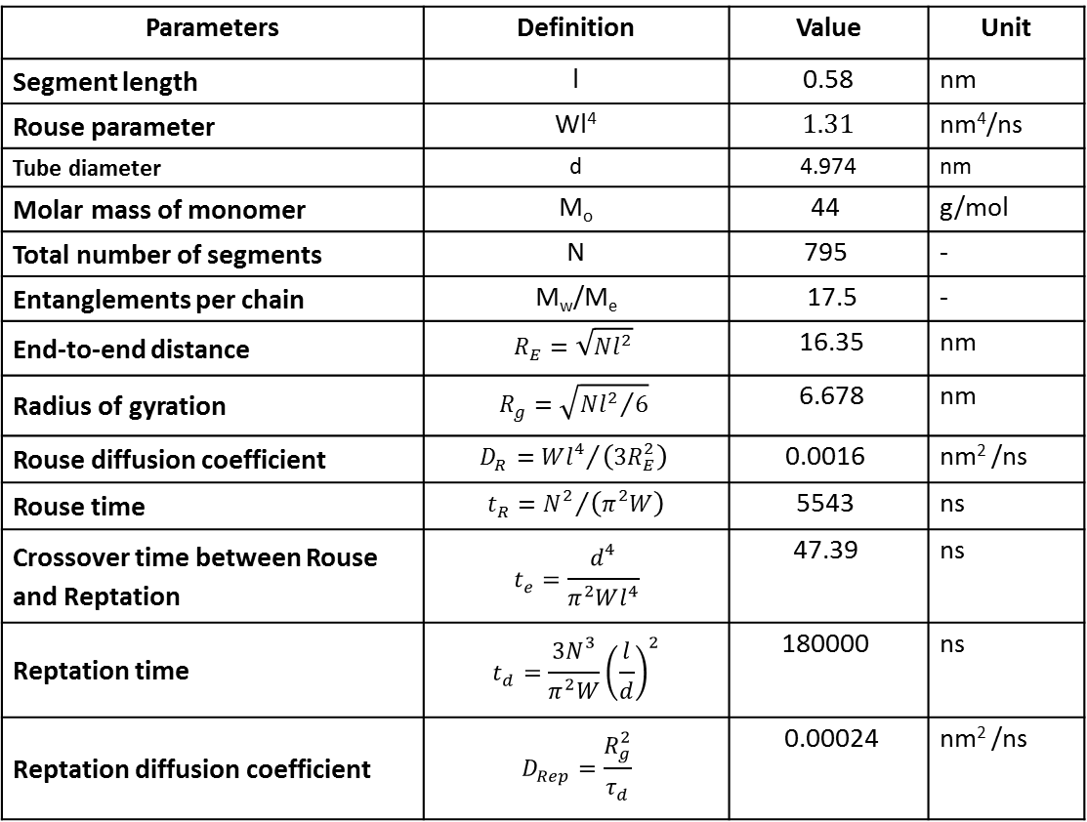
Table of output parameters
Parameters | Definition | Value | Unit
Segment length | l | 0.58 | nm
Rouse parameter | Wl⁴ | 1.31 | nm⁴/ns
Tube diameter | d | 4.974 | nm
Molar mass of monomer | M_{o} | 44 | g/mol
Total number of segments | N | 795 | -
Entanglements per chain | M_{w}/M_{e} | 17.5 | -
End-to-end distance | $$R_{E}=\sqrt{Nl^{2}}$$ | 16.35 | nm
Radius of gyration | $$R_{g}=\sqrt{{Nl^{2}}/6}$$ | 6.678 | nm
Rouse diffusion coefficient | $$D_{R}={Wl^{4}}/{\left(3R_{E}^{2}\right)}$$ | 0.0016 | nm² /ns
Rouse time | $$t_{R}={N^{2}}/{\left(π^{2}W\right)}$$ | 5543 | ns
Crossover time between Rouse and Reptation | $$t_{e}=\frac{d^{4}}{π^{2}Wl^{4}}$$ | 47.39 | ns
Reptation time | $$t_{d}=\frac{{3N}^{3}}{π^{2}W}{\left(\frac{l}{d}\right)}^{2}$$ | 180000 | ns
Reptation diffusion coefficient | $$D_{Rep}=\frac{R_{g}^{2}}{τ_{d}}$$ | 0.00024 | nm² /ns

Slide 27
Fundamental equations of NSE and output
Fourier time
Resolution taken with charcoal (high coherent signal, no dynamics)
Background is with empty can: Transmission fraction used for background subtraction

Slide 28
Backup slides
Choice of wavelengths (time and length scales)
Equations
Table of calculated parameters
Fitting pol vs phase

